Slide 1
Student Seminar - IDP
Presentation 6
Can Ersoy - 03.11.2026
Notes:
Spent most of the time on setting up stuff and handling db sync between gpu servers and my local pc

Slide 2
Why do some papers have no extractions even though they were classified as relevant?
Some keywords trigger relevancy
  Example: “self-assembly” and “tetrapeptide” in abstract/title but paper is about AI model and doesn’t mention any actual experiment data (lower confidence but still relevance classification)
Currently, tables and images are left out of what is sent to the LLM
9/38 papers actually got at least one entry in a second extraction run
(1 of these papers had 14 entries with length=1)
Notes:
Some papers more heavily use tables and images so that is one potential reason why those papers dont have any entries extracted
Some papers actually had extractable data, that was also not only in tables/images…
There will be issues due to non deterministic nature of LLMs

Slide 3
2) How can there be extractions with length=1
Extractions leave out termini from sequences:
  Fmoc-Lys(Fmoc)-OH -> sequence: K (Lysine - Lys)
  Fmoc-Glu -> sequence: E (Glutamic Acid - Glu)
Some papers use numbers to refer to multiple peptides to make it easier for the reader (e.g peptide 1 -> sequence:1)
  Current field description: Peptide sequence in letters. (e.g. 'FF')
  Maybe something like: Peptide sequence in valid IUPAC single character coding
Notes:
First case how does it self-assemble: It uses the termini (like Fmoc here for example) -> Gemini told me this
Second case: When the sequence is not written out in the paper with letters and numbers are given, since we don’t check it, extractions just referred to the number since sequence is a mandatory field. Should set some rules here on how the sequence looks like (would IUPAC encoding work? - current desc:

Slide 4
3) What distinguishes papers with high extraction counts from the others?
Some papers directly give the IUPAC encodings, making it easier for the LLM to extract
Some papers compare different sequences, meaning the information is close to each other allowing LLM to extract easily
Some papers give more information in tables/images and not in text (same as Q1)

Slide 5
New Queries (db=pmc instead of db=pubmed)
Basically “peptide self-assembly” + year information due to api return limit of 10k (in total ~55k results) + pmc open access subset
”("peptid"[All Fields] OR "peptidal"[All Fields] OR "peptide s"[All Fields] OR "peptides"[Supplementary Concept] OR "peptides"[All Fields] OR "peptide"[All Fields] OR "peptides"[MeSH Terms] OR "peptidic"[All Fields]) AND "self-assembly"[All Fields] AND (open_access[Filter]) AND ({}:{}[pdat]) AND (pmc_public[Filter])”
Notes:
Text “peptide self-assembly” was transformed that resulted in 55k papers to be returned.
We were only using title and abstract before but now it searches across all fields…
There are also papers whose language is not English (which actually shouldn’t be an issue since LLMs are really good at translation)

Slide 6
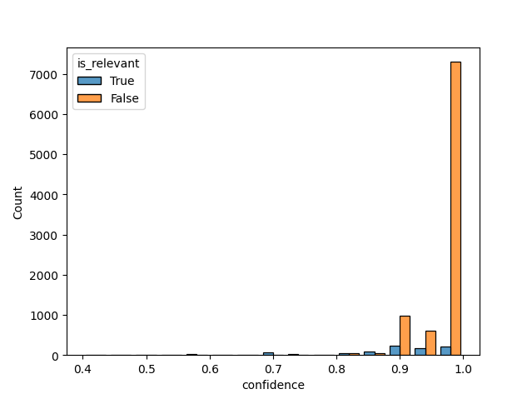
Relevance Check (first ~10k)
Model: gemma4:26b (MoE)
Time: ~13h
is_relevant (9850):
True: 881 papers
False: 8969 papers

Slide 7
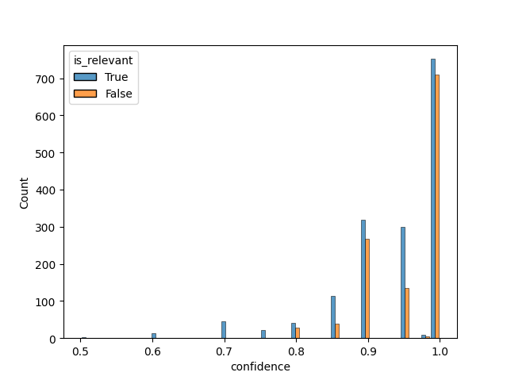
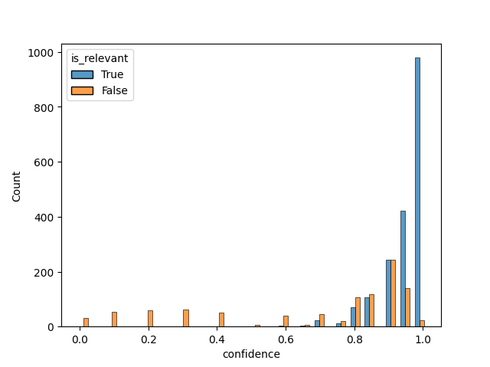
Comparison (Gemini 3.5 Flash Lite and Gemma 4 26B)
Gemma 4 26b
Gemini 3.5 Flash Lite
Notes:
Here it is actually about the confidence level, relevant-non relevant ratio is not that different

Slide 8
Notes on LLMs
Tested models around ~120b size, increasing parameter count improves extraction
Dense models same size seem to perform better (for extraction task) than MoE, but are slower
Speed is mostly determined by whether the model fits onto a single GPU or not (also model size)
Notes:
An interesting note on how much slower llm tasks become when multiple gpus are used…
You saw: 13h for around 10k papers (that was on single gpu - server 2)
This one has around 2800 papers and took 20.5 hours due to being fragmented into gpus

Slide 9
Next Steps
Test assumptions (e.g enforce IUPAC to lower sequence extraction errors…)
Add tables (TableNode) to passed texts and compare extraction performance for table heavy papers
Add improved logging for better error handling

